Slide 1
MRI Image Synthesis for the Diagnosis of Parkinson’s Disease
Neeyanth Kopparapu
Junior, Thomas Jefferson High School

Slide 2
2,500,000,000
Gigabytes of data produced daily
Notes:
Say the Statistic, then say “5 years ago our current state of technology could not keep up… this is really where artificial intelligence began to rise”

Slide 3
AI in Diagnostics
Large amount of data perfect for AI
Room for improvement
Millions of lives affected by improvements in this field
Notes:
“AI has a lot of potential in diagnostics since the modern data revolution… each medical device from MRI scanners to Glucose Meters record data to send to a doctor or to store for a patient. AI can capitalize on this information to form predictions.

Slide 4
Background
Parkinson’s Disease is one of the most common neurodegenerative disorders
Despite its prevalence, it’s diagnostic method hasn’t drastically improved in the past 20 years
Accuracy: 80.6%

Slide 5
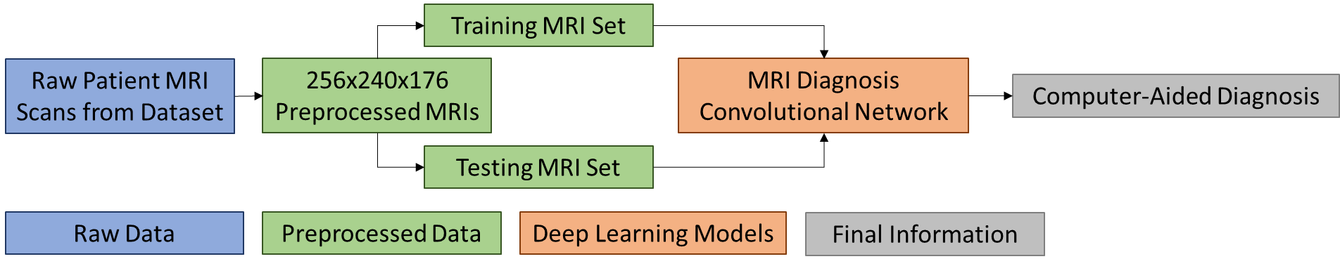
Initial Approach
Root Cause of Parkinson’s → Brain
Analyze MRI scans for signs of early PD
Used USC’s PPMI Project
Hundreds of MRIs from a diverse population
Image analysis used Convolutional Neural Networks

Slide 6
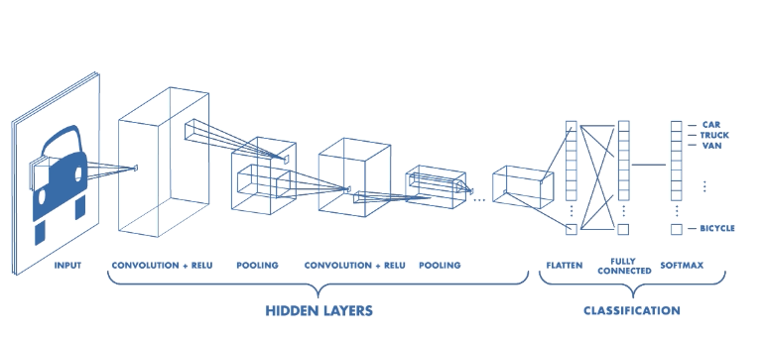
Convolutional Neural Networks
Artificial Neural Networks for Image Processing
Work with Kernel Convolutions
Many empirically tested CNNs (VGG, Resnet)

Slide 7
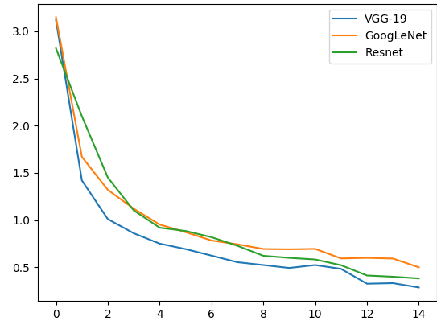
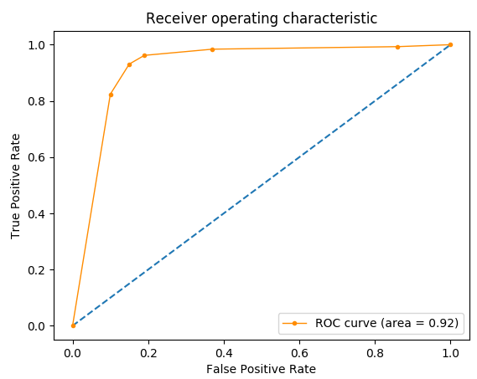
Initial Results
Best model has final accuracy of 90.2%
Higher than clinical accuracy, but improvements could be made.

Slide 8
Can We Do Better?
2

Slide 9
Problems with Initial Attempts
Lack of available data
Hundreds, instead of thousands, of samples
“Off-the-shelf” classification models
Initially used 3D-adapted VGG19, GoogleNet, Resnet for classification

Slide 10
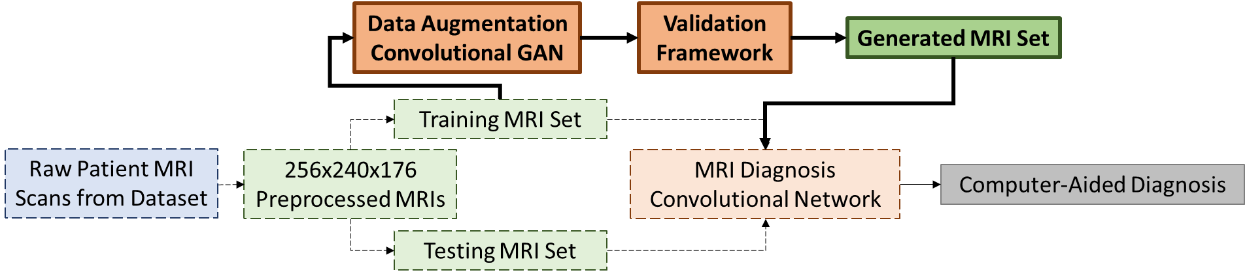
Solving the Low-Data Problem
Low-shot learning fairly common now
Opted to use generative methods for data augmentation
Could be generally applied to the field of healthcare
Decided to use a Generative Adversarial Network.

Slide 11
Generative Adversarial Networks
GANs are a flavor of generative networks
Adversarial – comprise of two different networks
Has a variety of applications in different fields

Slide 12
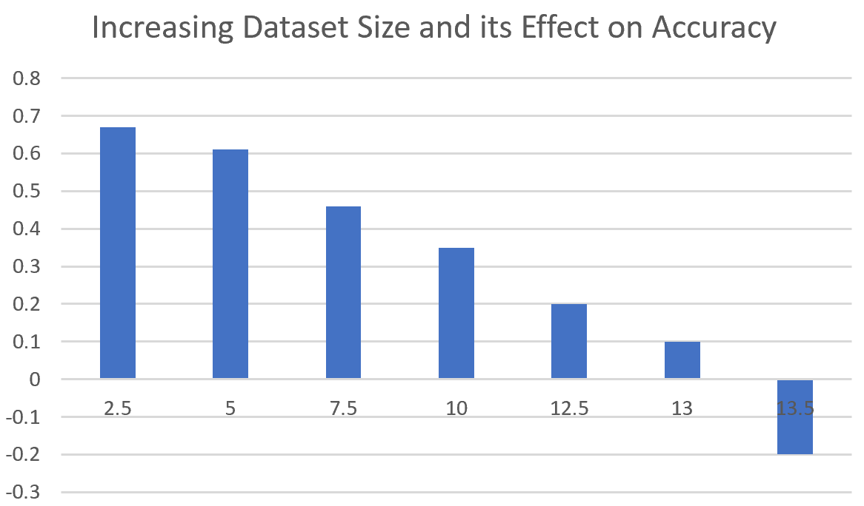
How many Images to Generate?
Too many → tainting original dataset
Law of Diminishing Returns
Simulated different contributions to the dataset
≈13% optimal
Tarnishing original dataset
might make model look for
potentially incorrect features

Slide 13
Not-so Perfect Images
Some images generated were not brain-like
Had to root out the bad images
Option to do manual or automatic
Although automatic may not catch everything, more generalizable

Slide 14
Brain-Border Validation
To check if images were correct, a simple border intact check was created
Common edge detection was used to create the edges and check if they were intact.
Overall, removed generated images till at least 13% of the size of original dataset were good images added into the dataset.
Only ≈4% of generated images had visual problems in some way.

Slide 15
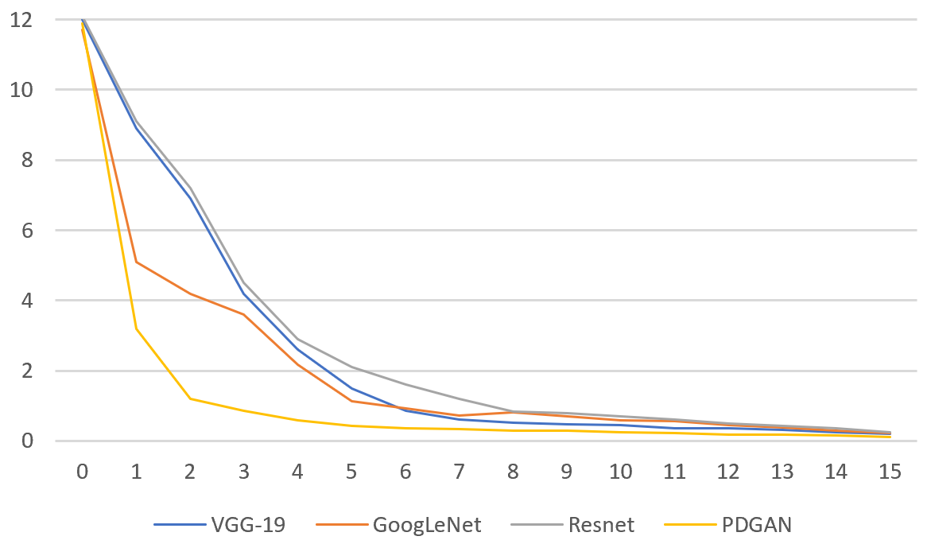
Updated Results
With the generated image, all of the “off-the-shelf” models improved accuracy.
The testing set was completely real images
Some models looked for different features
Model | Accuracy | Sensitivity | Specificity
VGG-19 | 89.29% | 91.32% | 85.24%
VGG-19 | 94.12% | 94.83% | 91.89%
GoogLeNet | 84.97% | 86.21% | 81.08%
GoogLeNet | 91.50% | 92.24% | 89.19%
Resnet-50 | 88.89% | 92.24% | 78.38%
Resnet-50 | 89.54% | 87.93% | 94.59%

Slide 16
Using General Models
Models originally used are good for general classification
Not necessarily good for MRI classification or Healthcare problems in general
Creating a new model potentially increases accuracy
Few non-traditional improvements were made

Slide 17
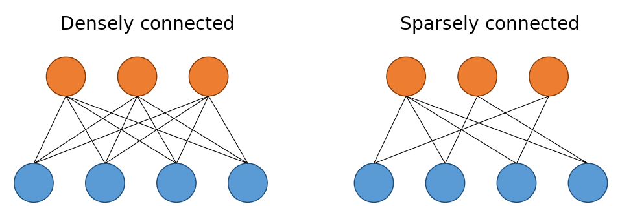
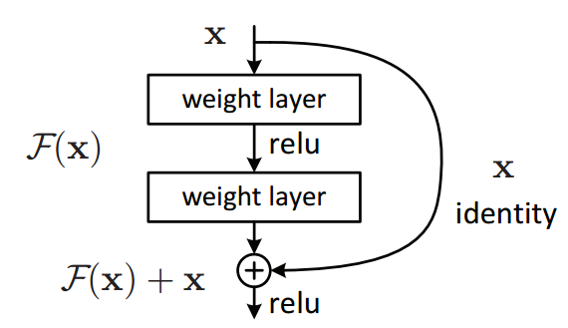
Sparsely Connected Nets & Residual Learning
To decrease training time, two common machine learning techniques are utilized.
Reduced training time by at least a factor of 4

Slide 18
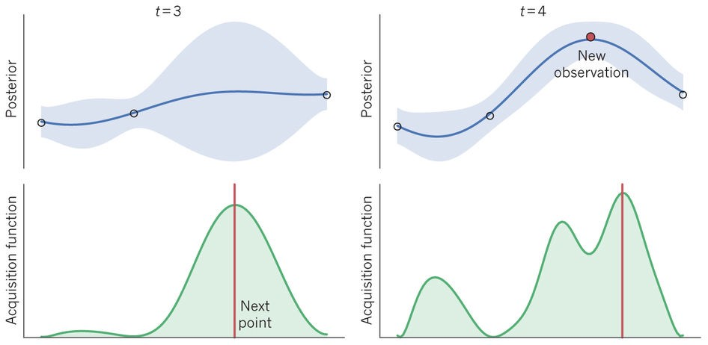
Bayesian Optimization
Hyperparameter Optimization was done using Bayesian Optimization
Spearmint Python Package

Slide 19
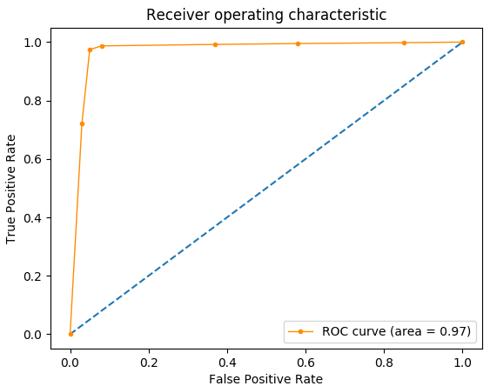
Overall Results
The Compiled Model attained an average accuracy of 96.62% over 8 folds
Sensitivity: 97.41%, Specificity: 94.59%
16% Higher than current clinical diagnosis

Slide 20
Looking Forward
3

Slide 21
Final Thoughts
Data: One of Healthcare Informatics’ Biggest Problems
Potential Solutions for Data Augmentation
Biased Data & Unethical Training Practices
Replacing Doctor’s with Machines
Explainability
Ethical Training

Slide 22
AI in Diagnostics
Will it Replace Doctors?
Loss of Jobs?
How can we justify outputs?
Trust among patients?
How can we scale this?
What should be prioritized?
What happens if the AI is wrong?

Slide 23
Thank You!
Neeyanth Kopparapu
Junior, TJHSST
neeyanthkvk@gmail.com
@neeyanth

